Slide 1
Token Embeddings

Slide 2

Why token embeddings, not word embeddings?
Problem with word-level embeddings
If we embed full words:
Huge vocabulary (millions of words)
Cannot handle unknown words (OOV)
Poor handling of:
  Rare words
  Morphology (running, runs, runner)
Solution → Sub-word tokenization
Break words into meaningful pieces that can be reused.

Slide 3
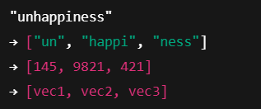
Token embedding in transformers
A token embedding is a dense vector representation of a sub-word token, not necessarily a full word.
Each token gets its own embedding vector, learned during training.
Key advantages
✔ Handles unknown words
✔ Reduces vocabulary size
✔ Learns morphology and semantics
✔ Language independent
✔ Works well for technical & rare terms
Popular Sub-word tokenization method:
BPE (Byte Pair Encoding) -> Used in: GPT, RoBERTa, LLaMA
Wordpiece -> Used in: Bert

Slide 4
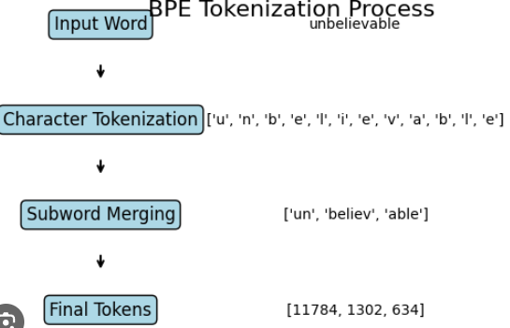
Byte Pair Encoding - BPE - Used in GPT, Llama, etc.,
BPE is a text tokenization method, that breaks words into common subword units by repeatedly merging the most frequent adjacent characters or symbols.
How BPE works (intuitively)
Start with characters
Repeatedly merge the most frequent character pairs
Stop when vocabulary size is reached
Note:
Initial Vocabulary: { l, o, w, e, r, n, i, g, </w> } → size = 9
Eg. target_size: 13
Number of merges = target_size - initial_size => 13-9 = 4 (so totally 4 merges are possible) -> { l, o, w, e, r, n, i, g, </w>, lo, low, er, in }
Vocabulary size: 30K [number of tokens (characters + subwords)] (In Llama ~ vocabulary size is 32k ) - To handle memory, speed in effectiveway

Slide 5




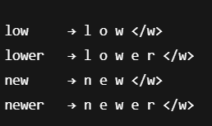
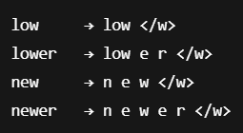
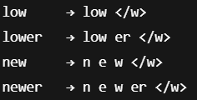
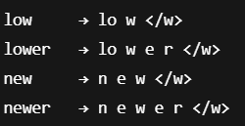


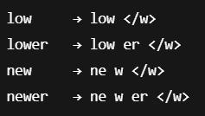
Step-by-Step with a tiny 4-word corpus
Let our training corpus be just 4 words:
Start with character level tokens - BPE always starts with tokens
Count frequency of adjacent pairs
Merge the most frequent pairs - pick one of the high-frequency pair
Apply the merge everywhere and include with vocabulary
Repeat this process and stop when vocabulary size is reached. -> {l,o,w,n,e,r’,</w>,lo,low,er,ne,new}

Slide 6
Tokenizing the new token word (never seen before)
New word: lowering
Start with characters: l o w e r i n g </w>
Applying the training learned merges: “low” “er” “i” “n” “g” </w>
Final token: ["low", "er", "i", "n", "g"]
So,
No OOV problem
Reuses known subwords

Slide 7

WordPiece Tokenization - Used in BERT
Choose sub-words that maximize likelihood of training data.
using a '##' prefix to denote subwords
The learning strategy of Wordpiece is quite similar of BPE but the way of calculating the token is different
Example:
Corpus: [lowest, lower]
Initial vocabulary: {l, ##o, ##w, ##e, ##s, ##t, ##r}
1. Initial split: {l, ##o, ##w, ##e, ##s, ##t, ##r}
2. Compute pair score:
{l, ##o} -> “lo” pair freq. Is 2 times and “l” freq is 2 and “o” freq is 2 → The same process will happen for other pairs (ow, we,es,st, er)
3. Now the updated vocabulary is:{l, ##o, ##w, ##e, ##s, ##t, ##r, lo}
4. Now the updated split is: {#lo #w #e #s #t, #lo #w #e #r} -> Repeat the steps from 2 to 4 again

Slide 8
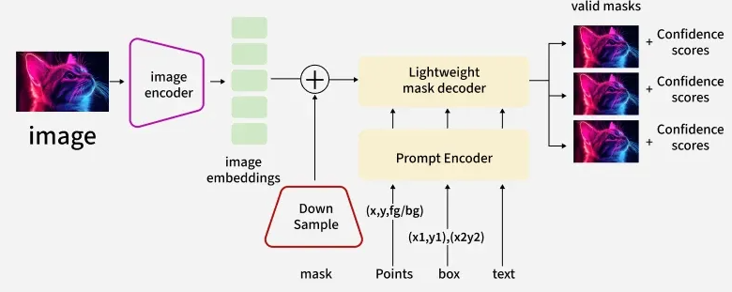
SAM - Segment Anything Model
SAM (Segment Anything Model) is a foundation model for image segmentation developed by Meta AI (Facebook AI Research) in 2023.
It is designed to segment any object in an image with minimal human input, making segmentation promptable, general-purpose, and reusable across domains.
1. What problem does SAM solve?
Traditional segmentation models:
Are trained for specific datasets (medical, satellite, driving, etc.)
Need task-specific fine-tuning
Fail on unseen object categories
SAM changes this by acting like:
“GPT for image segmentation”
Once trained, it can segment unknown objects without retraining.

Slide 9
Segment Anything Model
Training data behind SAM
Trained on SA-1B dataset
1 billion masks
11 million images
Largest segmentation dataset ever created
This massive scale gives SAM its strong generalization.
Advantages:
✅ Zero-shot segmentation
✅ Works on unseen object categories
✅ No task-specific fine-tuning
✅ Interactive and fast
✅ Can generate multiple mask proposals
https://aidemos.meta.com/segment-anything/gallery/
https://blog.roboflow.com/segment-anything-breakdown/

Slide 10
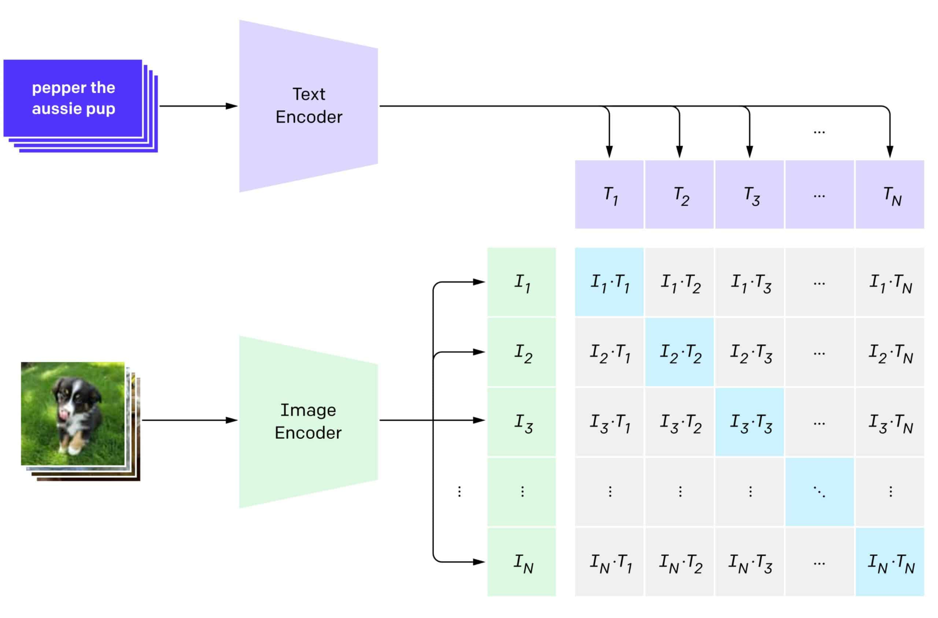
CLIP - Contrastive Language-Image Pre-training
CLIP (Contrastive Language–Image Pretraining) is a multimodal foundation model developed by OpenAI that learns to connect images and natural language.
In simple terms:
CLIP understands images by reading text, and understands text by looking at images.
1️⃣ Image Encoder
CNN (ResNet) or Vision Transformer (ViT)
2️⃣ Text Encoder
Transformer-based language model -BERT or GPT-2

Slide 11
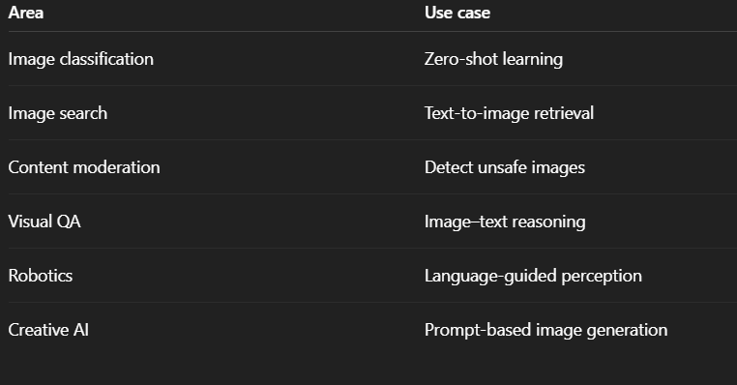
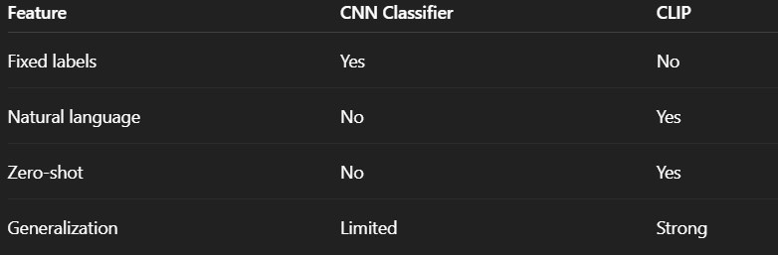
CLIP - Contrastive Language-Image Pre-Training

